Slide 1
Plan for LAMPS at KoRIA
The Second International Symposium on Nuclear Symmetry Energy
Smith College, Northampton, Massachusetts, U.S.A., June 17-20, 2011
Byungsik Hong (Korea University)
Outline
Brief introduction to KoRIA
Physics of Symmetry Energy for Dense Matter
Design of LAMPS detector system
Summary

Slide 2
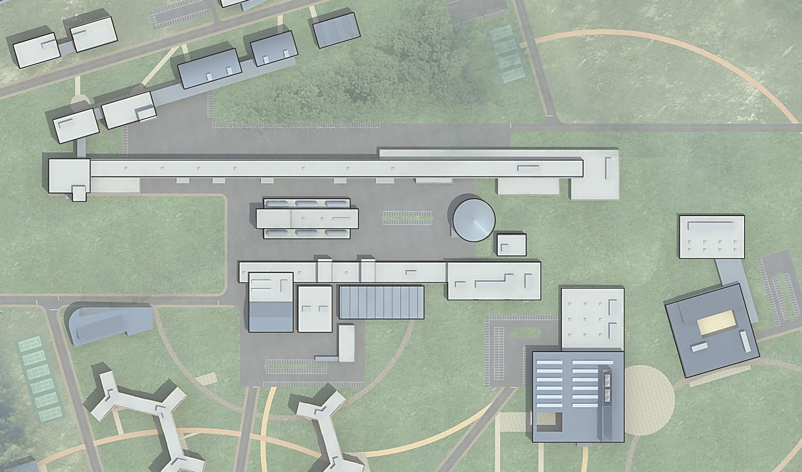
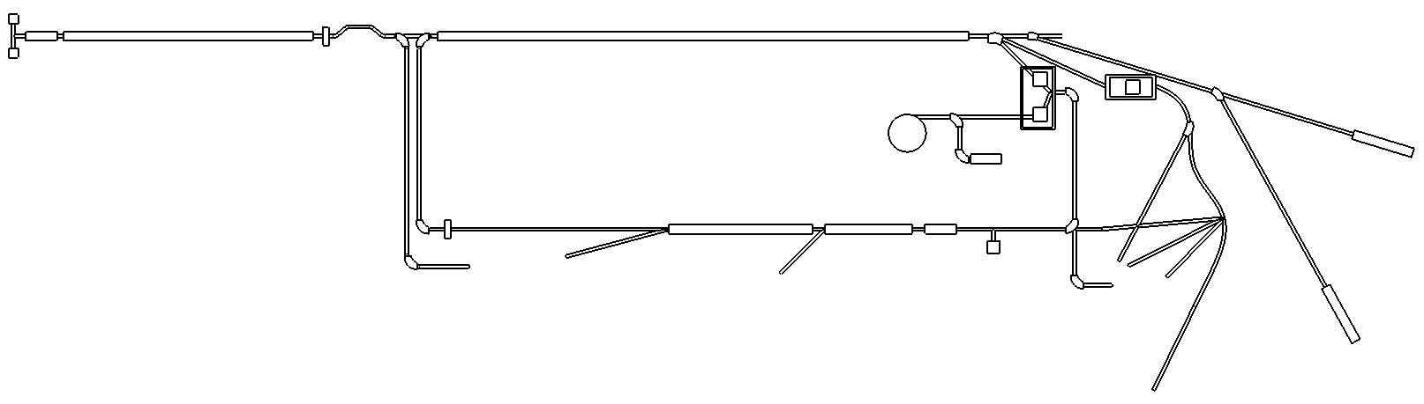
KoRIA: Korea Rare Isotope Accelerator
250 MeV/u, 9Ⅹ10⁸pps(¹³²Sn)
200 MeV/u, 8pμA (U)
28GHz SC ECR IS
IFF LINAC
RFQ
SCL
SCL
Future extension
β=0.041, β=0.085
QWR QWR
Stripper
β=0.285, β=0.53
HWR HWR
400KW
H₂+
D+
ISOL
Target
Cyclotron
p: 70/100MeV, 1mA
In-flight
Target
70KW
ISOL LINAC
Nuclear Data
Nuclear Data
17.5 MeV/u
SCL
SCL
RFQ
Stripper
β=0.10
QWR
β=0.04
QWR
ECR IS
Fragment
Separator
Low-energy experiments
Atomic
Physics
Nuclear Astrophysics
Material Science
Bio Science
Medical Science
High-energy
Experiments
(LAMPS)
Nuclear Physics

Slide 3
Aim of Technical Specification
High-intensity RI beams by ISOL & IFF
  70 kW ISOL from direct fission of ²³⁸U induced by 70 MeV protons with the current of 1 mA
  400 kW IFF by 200 MeV/u ²³⁸U with the current of 8pμA
  E.g., ¹³²Sn at ~250 MeV/u up to 9ⅹ10⁸ pps (See next page)
More exotic RI beams by using multi-step RI production processes
  Combination of ISOL & IFF
Design Philosophy
  Simultaneous operational mode for maximal use of the facility
  Keep the diversity

Slide 4
IFF Linac Beam Specification
Ion Species | Z/ A | Ion source output |  | SC linac output
 |  | Charge | Current (pµA) | Charge | Current (pµA) | Energy (MeV/u) | Power (kW)
Proton | 1/ 1 | 1 | 660 | 1 | 660 | 610 | 400
Ar | 18/ 40 | 8 | 42.1 | 18 | 33.7 | 300 | 400
Kr | 36/ 86 | 14 | 22.1 | 34-36 | 17.5 | 265 | 400
Xe | 54/ 136 | 18 | 18.6 | 47-51 | 12.5 | 235 | 400
U | 92/ 238 | 33-34 | 11.7 | 77-81 | 8.4 | 200 | 400
Estimated RIBs based on ISOL
Isotope | Half-life | Yield at target (pps) | Overall eff. (%) | Expected Intensity (pps)
⁷⁸Zn | 1.5 s | 2.75 x 10¹⁰ | 0.0384 | 1.1 x 10⁷
⁹⁴Kr | 0.2 s | 7.44 x 10¹¹ | 0.512 | 3.8 x 10⁹
⁹⁷Rb | 170 ms | 7.00 x 10¹¹ | 0.88 | 6.2 x 10⁹
¹²⁴Cd | 1.24 s | 1.40 x 10¹² | 0.02 | 2.8 x 10⁸
¹³²Sn | 40 s | 4.68 x 10¹¹ | 0.192 | 9.0 x 10⁸
¹³³In | 180 ms | 1.15 x 10¹⁰ | 0.184 | 2.1 x 10⁷
¹⁴²Xe | 1.22 s | 5.11 x 10¹¹ | 2.08 | 1.1 x 10¹⁰

Slide 5
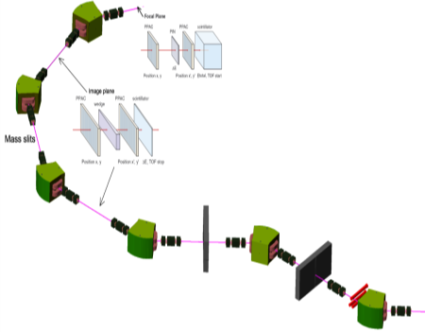
RI from ISOL by Cyclotron
IFF LINAC
200 MeV/u (U)
SC ECR IS
Future extension area
RFQ
SCL
SCL
Future plan
Stripper
Cyclotron
K~100
μ, Medical
research
H₂+
D+
ISOL LINAC
ISOL
target
In-flight
target
Medical science
SCL
RFQ
Charge
Breeder
Fragment
Separator
Low energy experiments
1
Atom trap
experiment
Nuclear Astrophysics
Material science
Bio science
Nuclear data
3
ISOL with cyclotron driver (70 kW)
2
Atomic / Nuclear physics
High energy
experiments
LINAC
1. ISOL → low E RI
Beam line [for acceleration]
Nuclear Physics
Beam line [for experiment]
2. ISOL → high E RI
Target building
Experimental Hall
3. ISOL → IFF → ISOL (trap)

Slide 6
RI from IFF by High-Power SC LINAC and High-Intensity Stable HI beams
IFF LINAC
200 MeV/u (U)
SC ECR IS
Future extension area
RFQ
SCL
SCL
Future plan
Stripper
Cyclotron
K~100
μ, Medical
research
H₂+
D+
ISOL LINAC
ISOL
target
In-flight
target
17.5 MeV/u (U)
> 11 pμA
Medical science
SCL
RFQ
4
Charge
Breeder
Fragment
Separator
Low energy experiments
5
Atom trap
experiment
Nuclear Astrophysics
Material science
Bio science
Nuclear data
6
7
Stable HI beams
IFF with stable heavy ions
Atomic / Nuclear physics
High energy
experiments
LINAC
4. Low E stable heavy ions
Beam line [for acceleration]
Nuclear Physics
Beam line [for experiment]
5. IFF → low E RI or ISOL (trap)
Target building
6. IFF → high E RI
Experimental Hall
7. High E stable heavy ions

Slide 7
RI from ISOL by High-Power SC LINAC
(Long term future upgrade option)
IFF LINAC
600 MeV, 660 μA
protons
SC ECR IS
Future extension area
RFQ
SCL
SCL
Future plan
Stripper
Cyclotron
K~100
μ, Medical
research
H₂+
D+
ISOL LINAC
ISOL
target
In-flight
target
Medical science
SCL
RFQ
Charge
Breeder
Fragment
Separator
Low energy experiments
8
Atom trap
experiment
ISOL with IFF LINAC
future high-power driver
400 kW (or ~MW) ISOL upgrade
Nuclear Astrophysics
Material science
Bio science
Nuclear data
Atomic / Nuclear physics
High energy
experiments
LINAC
8. High power ISOL
Beam line [for acceleration]
Nuclear Physics
Beam line [for experiment]
Target building
Experimental Hall

Slide 8
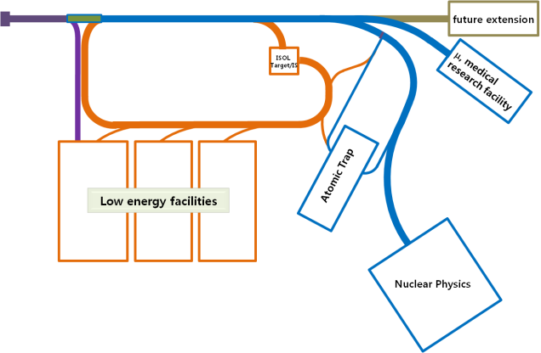
Research Goals
Nuclear Physics
Exotic nuclei near the neutron drip line
Super-Heavy Elements (SHE)
Equation-of-state (EoS) of nuclear matter
Nuclear Astrophysics
Origin of nuclei
Paths of nucleosynthesis
Neutron stars and supernovae
ISOL+IFF+ISOL
ISOL+IFF+ISOL(Trap)
Atomic physics
Limits of nuclear existence
Fundamental conservation law
Nuclear data using fast neutrons
Basic data for future nuclear energy
Radioactive waste transmutation
Material science
Production & Characterization of new materials
Dynamic image in nm scale
In this talk, I am
going to focus on the
isospin dependent EoS.
(Large help from B.-A. Li
in the WCU program)
Medical and Bio sciences
Advanced therapy technology
Mutation of DNA

Slide 9
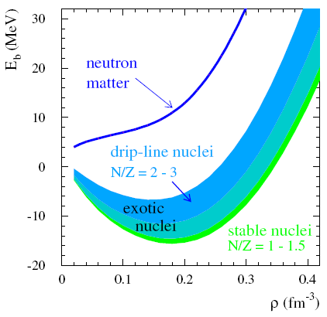
Nuclear Equation of State
B.-A. Li, L.-W. Chen
& C.M. Ko
Physics Report,
464, 113 (2008)
18
E/A (MeV)
Symmetric
nuclear matter
(ρ_{n}=ρ_{p})
CDR, FAIR (2001)
Isospin
asymmetry
0
ρ
Nucleon
density
δ
F. de Jong & H. Lenske, RPC 57, 3099 (1998)
F. Hofman, C.M. Keil & H. Lenske, PRC 64, 034314 (2001)
ρ (fm⁻³)

Slide 10
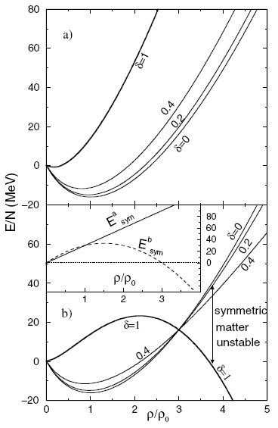
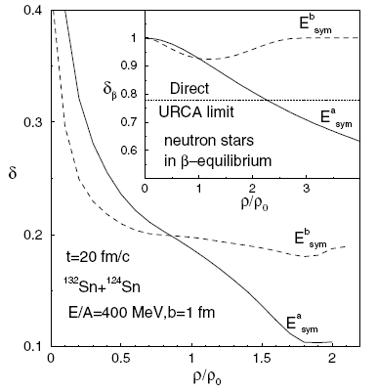
Nuclear Equation of State
Bao-An Li, PRL 88, 192701 (2002)
High (Low) density matter is more neutron rich with soft (stiff) symmetry energy

Slide 11
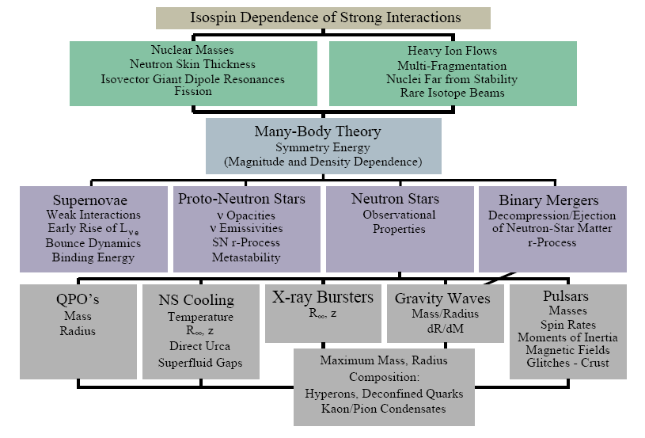
Importance of Symmetry Energy
RIB can provide crucial input.
Effective field theory, QCD
π⁻/π⁺
K⁺/K⁰
n/p
³H/³He
γ
isodiffusion
isotransport
+ isocorrelation
isofractionation
isoscaling
A.W. Steiner, M. Prakash, J.M. Lattimer and P.J. Ellis, Physics Report 411, 325 (2005)
Red boxes: added by B.-A. Li

Slide 12
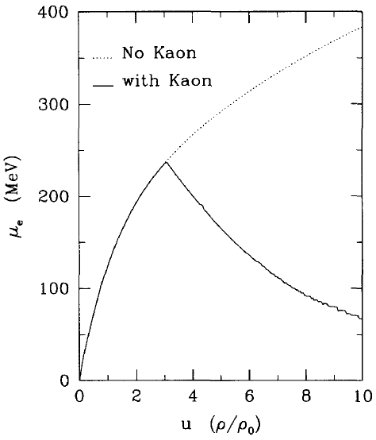
Stability of Neutron Stars with
Super Soft E_{sym}
If the symmetry energy is too soft, then a mechanical instability will occur when dP/dρ<0, neutron stars will, then, collapse.
Gravity
?
TOV equation: a condition at
hydrodynamical equilibrium
Nuclear pressure
For npe matter,
G.Q. Li, C.-H. Lee & G.E. Brown
Nucl. Phys. A 625, 372 (1997)
dP/dρ<0, if E’_{sym} is big and negative (super-soft)

Slide 13
Experimental Observables
Signals at sub-saturation densities
  Sizes of n-skins for unstable nuclei
  n/p ratio of fast, pre-equilibrium nucleons
  Isospin fractionation and isoscaling in nuclear multifragmentation
  Isospin diffusion (transport)
  Differential collective flows (v₁ & v₂) of n and p
  Correlation function of n and p
  ³H/³He ratio, etc.
Signals at supra-saturation densities
  π⁻/π⁺ ratio
  K⁺/K⁰ ratio (irrelevant to KoRIA energies)
  Differential collective flows (v₁ & v₂) of n and p
  Azimuthal angle dependence of n/p ratio with respect to the R.P.
Correlation of various observables
Simultaneous measurement of neutrons and charged particles

Slide 14
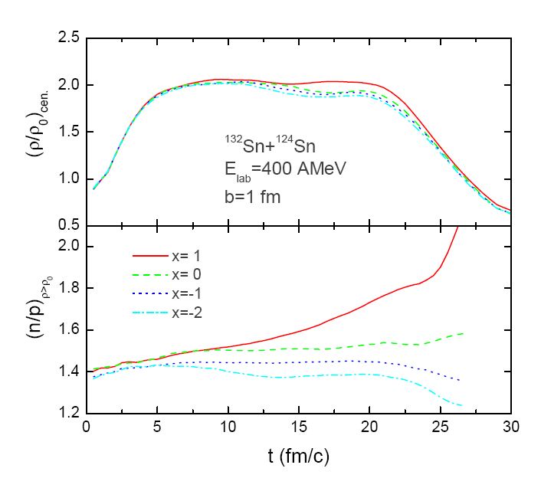
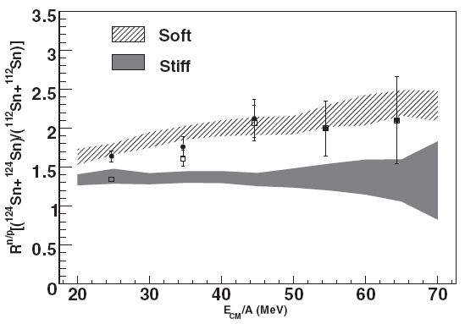
Yield Ratio
Central density
E_{sym}(ρ)=12.7(ρ/ρ₀)^{2/3}+17.6(ρ/ρ₀)^{γi}
Soft E_{sym}
ImQMD
Stiff E_{sym}
Y(n)/Y(p)
Double ratio: min. systematic error
More neutrons are emitted from the n-rich system and softer symmetry energies.
n/p
³H/³He
M. A. Famiano et al.
RPL 97, 052701 (2006)

Slide 15
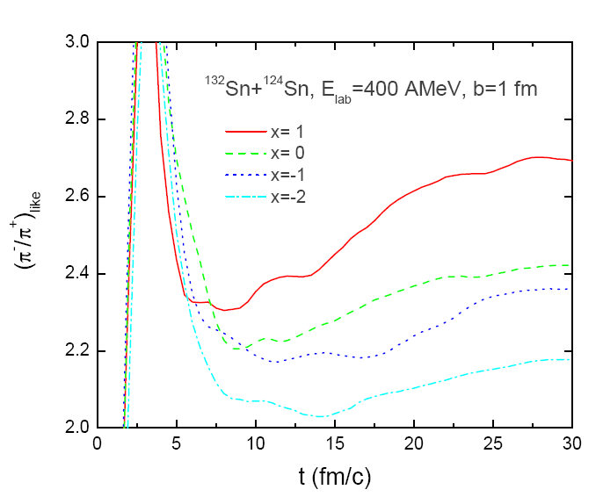
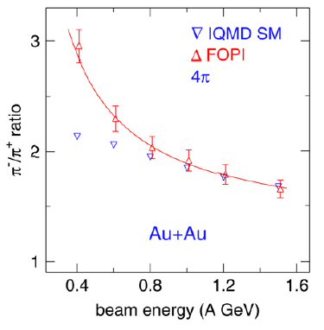
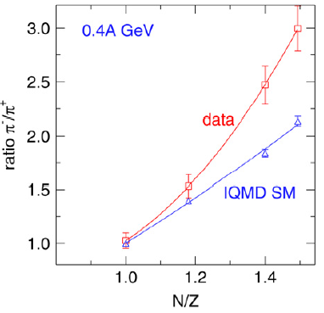
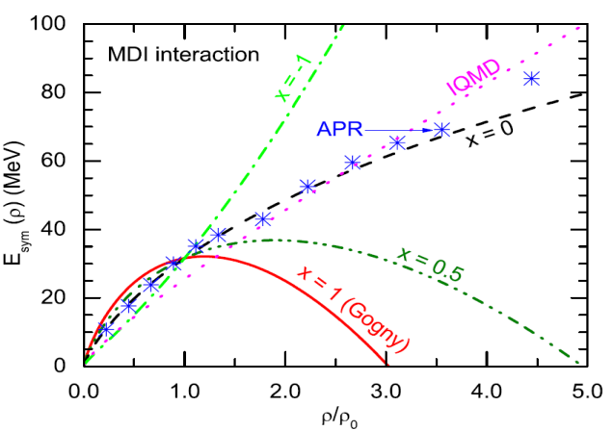
Yield Ratio (π⁻/π⁺)
Data: FOPI Collaboration, Nucl. Phys. A 781, 459 (2007)
IQMD: Eur. Phys. J. A 1, 151 (1998)
Need a symmetry energy softer than
the above to make the pion production
region more neutron-rich!

Slide 16
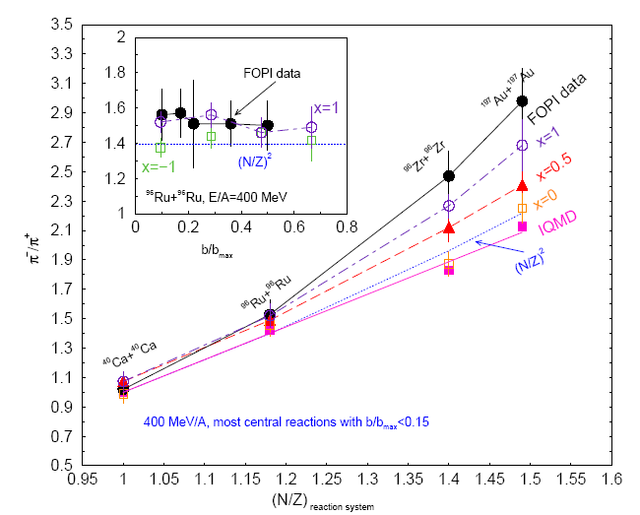
π⁻/π⁺ Ratio
Soft E_{sym}
KoRIA, etc
π⁻/π⁺
Stiff E_{sym}
(N/Z) _{reaction system}

Slide 17
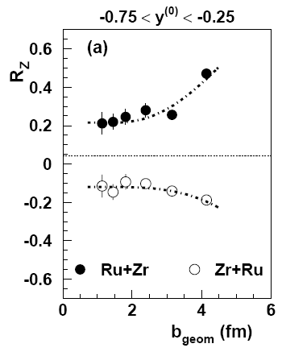
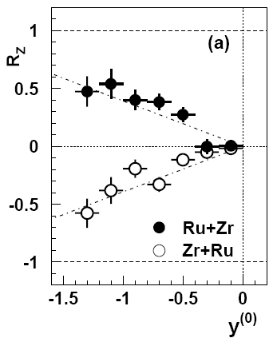
Isospin Diffusion Parameter:
Isospin Tracer
Isospin diffusion occurs only in asymmetric systems A+B
(No isospin diffusion between symmetric systems)
F. Rami et al., FOPI, PRL 84, 1120 (2000)
B. Hong et al., FOPI, PRC 66, 034901 (2002)
Y.-J. Kim & B. Hong, FOPI, To be published.
R_{i} = 0 for
complete isospin mixing
R_{i} = -1
R_{i} = +1

Slide 18
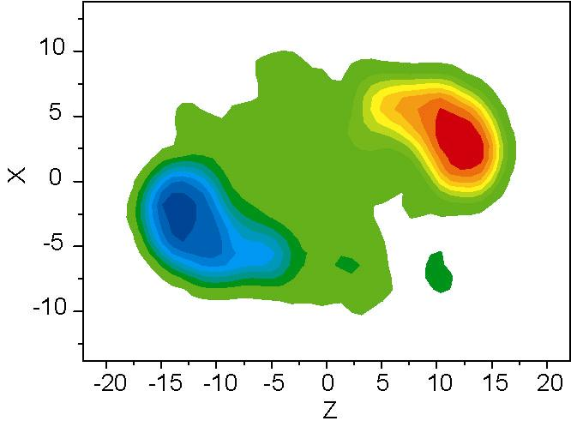
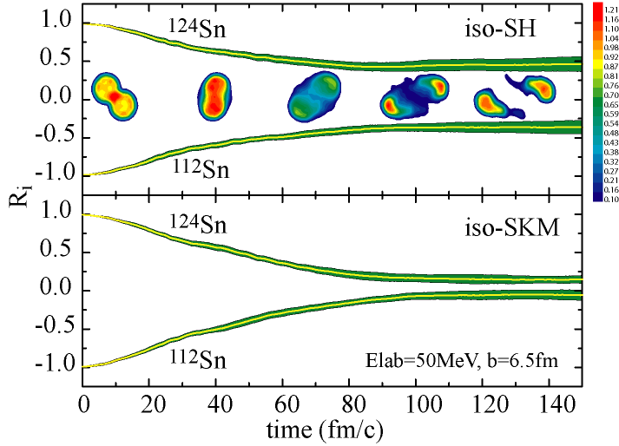
Isospin Diffusion Parameter
Projectile
¹²⁴Sn
stiff
soft
¹¹²Sn
Target
Symmetry energy drives system towards equilibrium
  stiff EOS : small diffusion (|R_{i}| ≫ 0)
  soft EOS : large diffusion & fast equilibrium (R_{i} → 0)
M.B. Tsang et al., PRL 92, 062701 (2004)

Slide 19
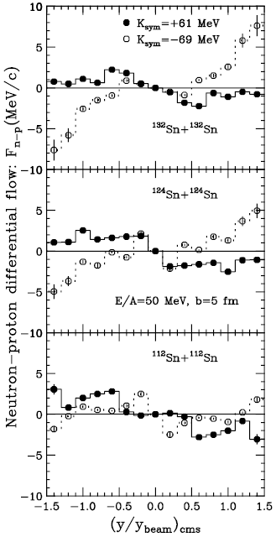
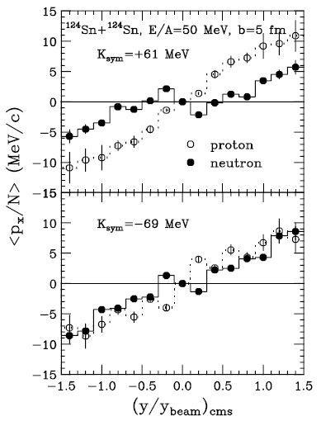
Collective Flow
Large
N/Z
B.-A. Li,
PRL 85, 4221
(2000)
Stiff
Also known as v₁
Super
Soft
Small
N/Z

Slide 20
Design of Detector System
We need to accommodate
  Large acceptance
  Precision measurement of momentum (or energy) for variety of particle species including π^{+/-} and neutrons with high efficiency
  Keep flexibility for other physics topics in the future
This leads to the design of LAMPS
  Large-Acceptance Multipurpose Spectrometer
Unique features of LAMPS
  Combination of solenoid and dipole spectrometers
  Movable arms
  Large acceptance of neutron detector with precision energy measurement

Slide 21
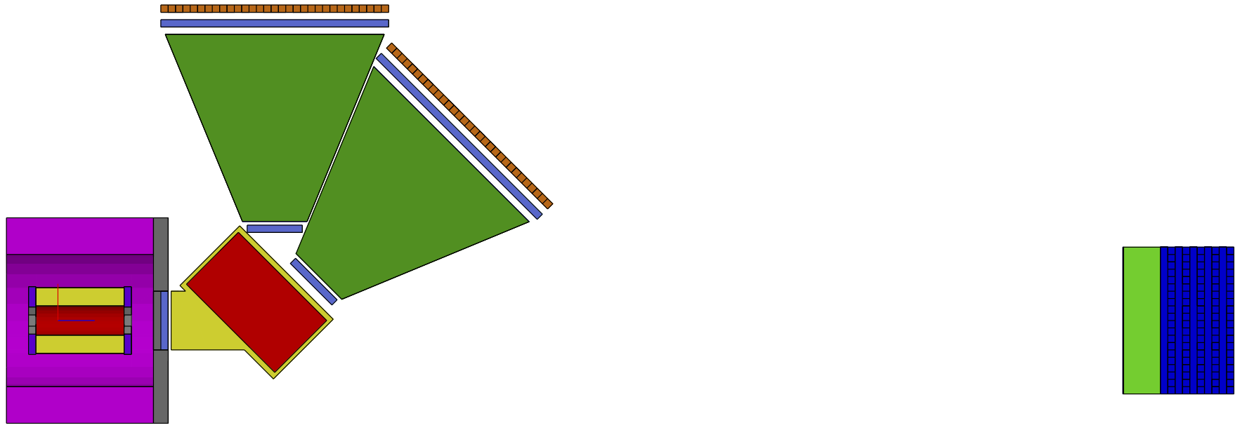
Conceptual Design of LAMPS
Dipole acceptance ~30mSr
Dipole length =1.0 m
TOF length ~8.0 m
For B=1.5 T,
p/Z ≈ 0.35 GeV/c
at 110º
Low p/Z
Neutron-detector array
High p/Z
For B=1.5 T,
p/Z ≈ 1.5 GeV/c at 30º
Solenoid
magnet
Dipole magnet: We can also consider the large aperture superconducting dipole magnet (SAMURAI type).

Slide 22
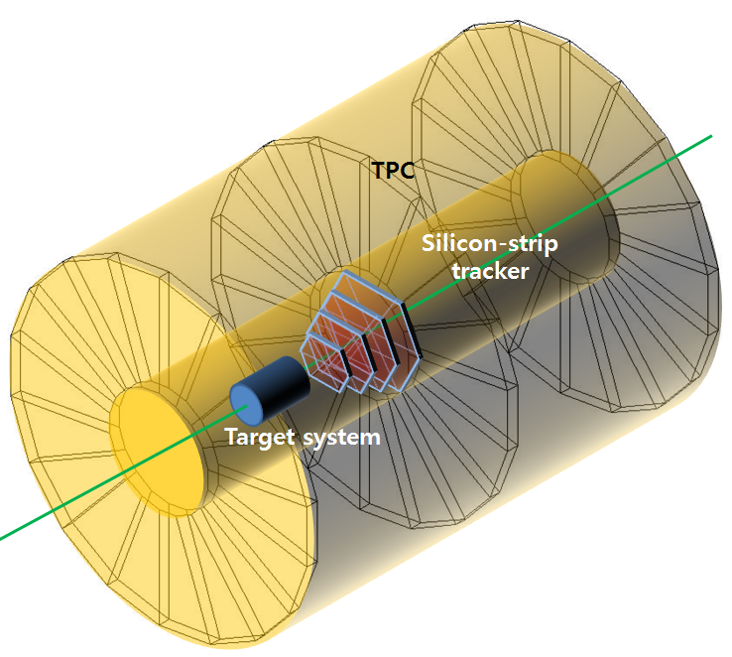
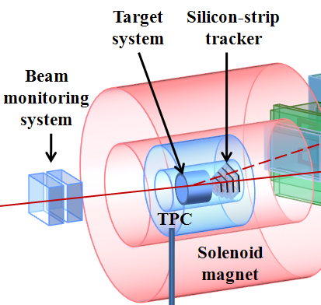
Solenoid Spectrometer
TPC: large acceptance (~3π Sr) for the measurements of π^{+/-} and light fragments
Silicon strip detector: 3~4 layers for nuclear fragments
Useful for event characterization

Slide 23
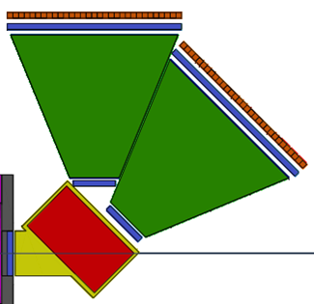
Dipole Spectrometer
Acceptance: > 50 mSr
Multiparticle tracking of p, d, t, and He isotopes, etc.
Tracking chambers: ≥ 3 stations of drift chambers (+pad readout possible) for each arm
ToF: Conventional plastic scintillatior detector or multigap RPC technology
  σ_{t} < 100 ps, essential for Δp/p < 10⁻³ @ β=0.5

Slide 24
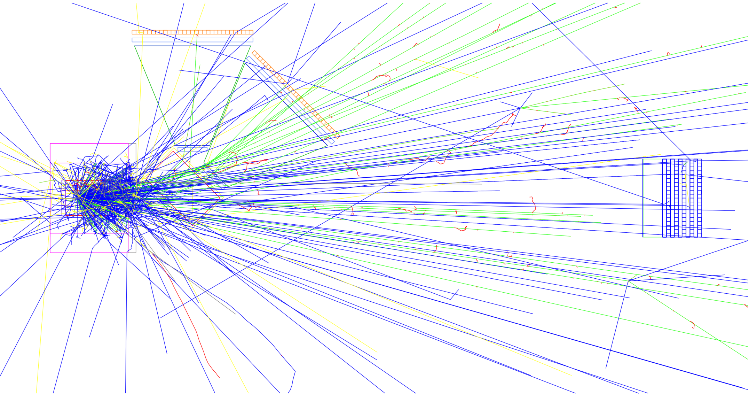
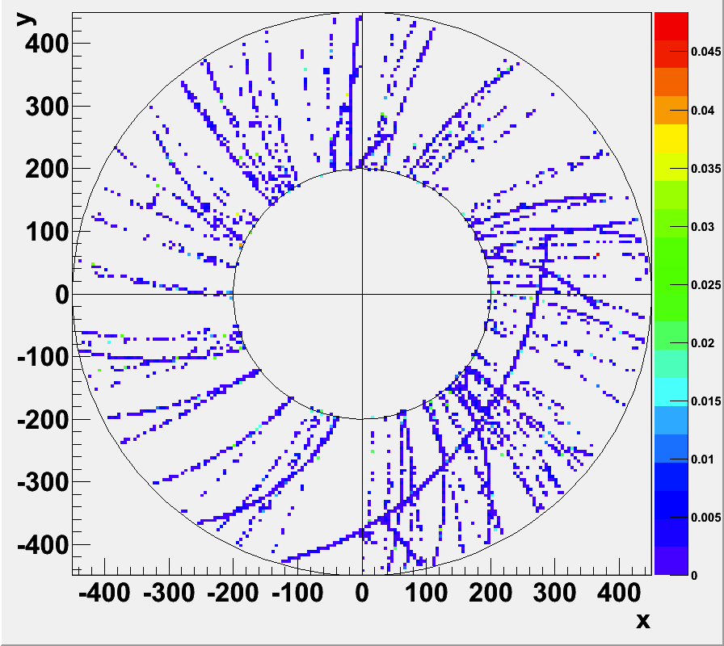
Simulated Event Display
IQMD(SM) for Au+Au at 250A MeV

Slide 25
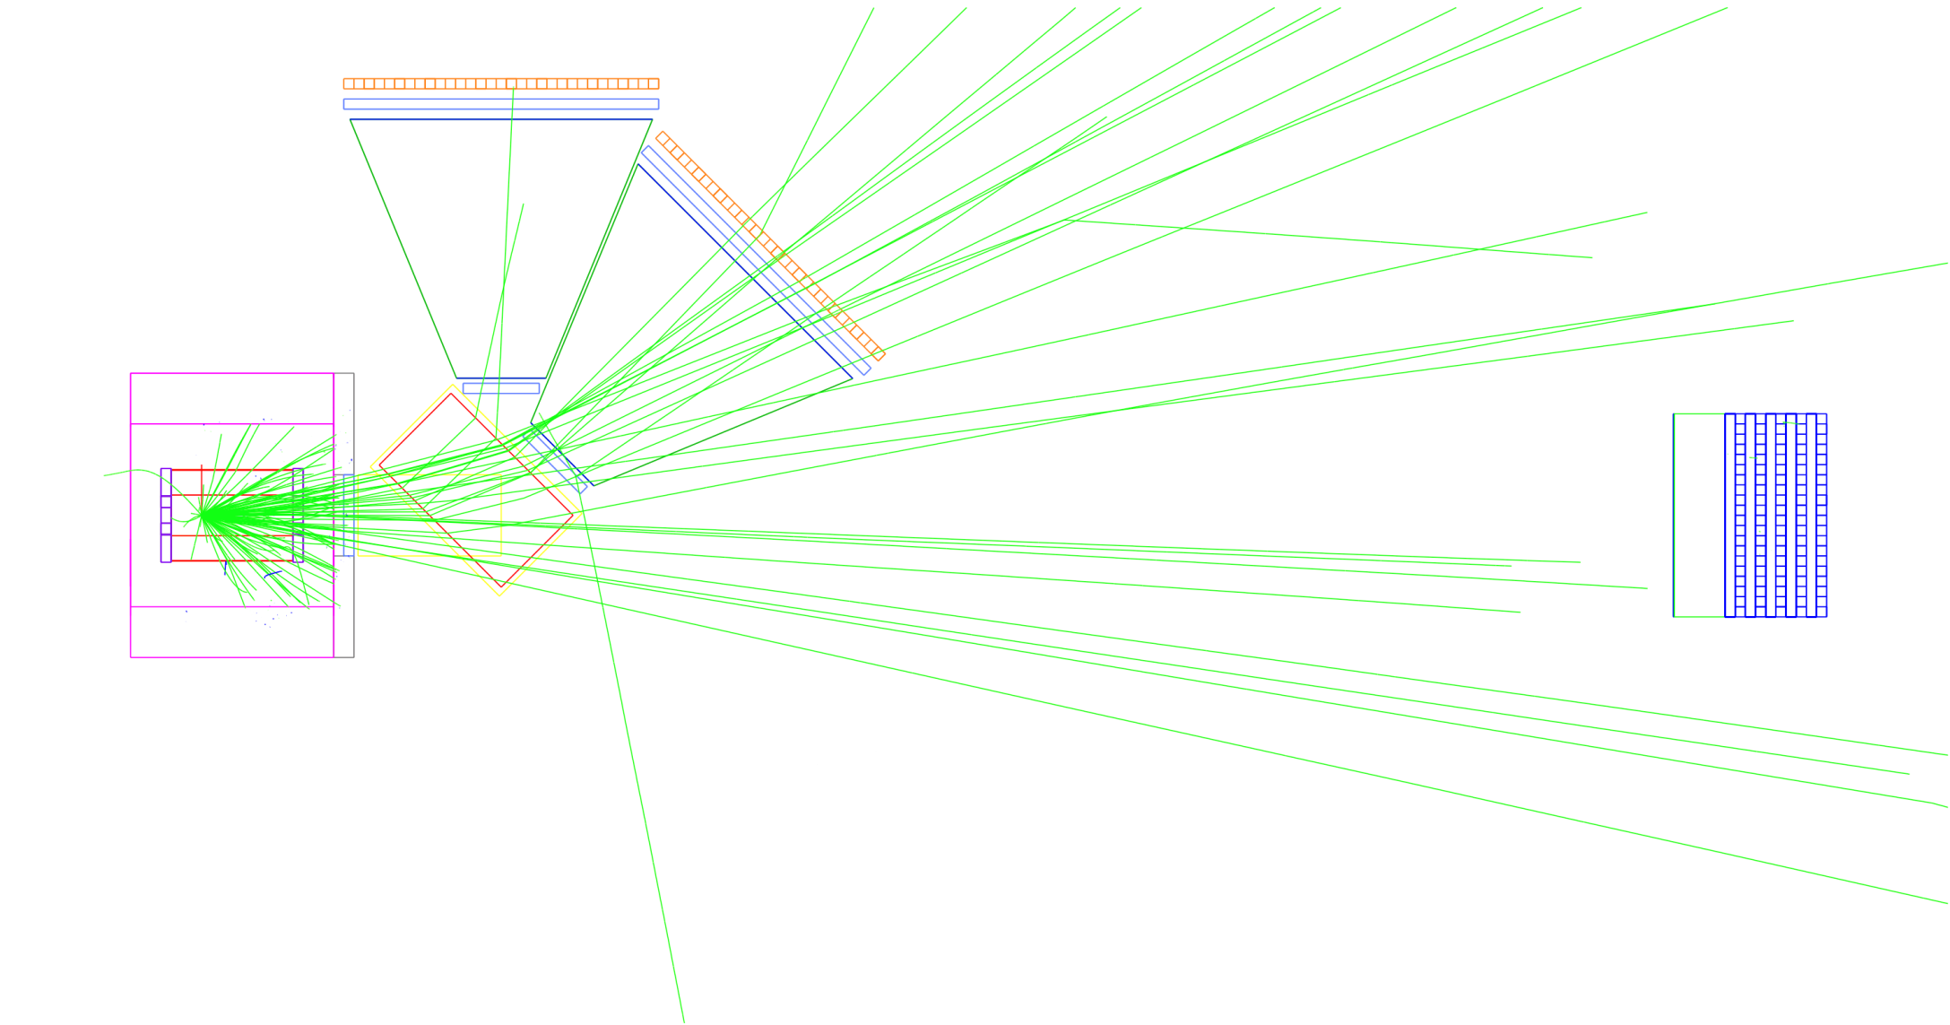
Simulated Event Display
IQMD(SM) for Au+Au at 250A MeV
Charged hadrons & fragments only

Slide 26
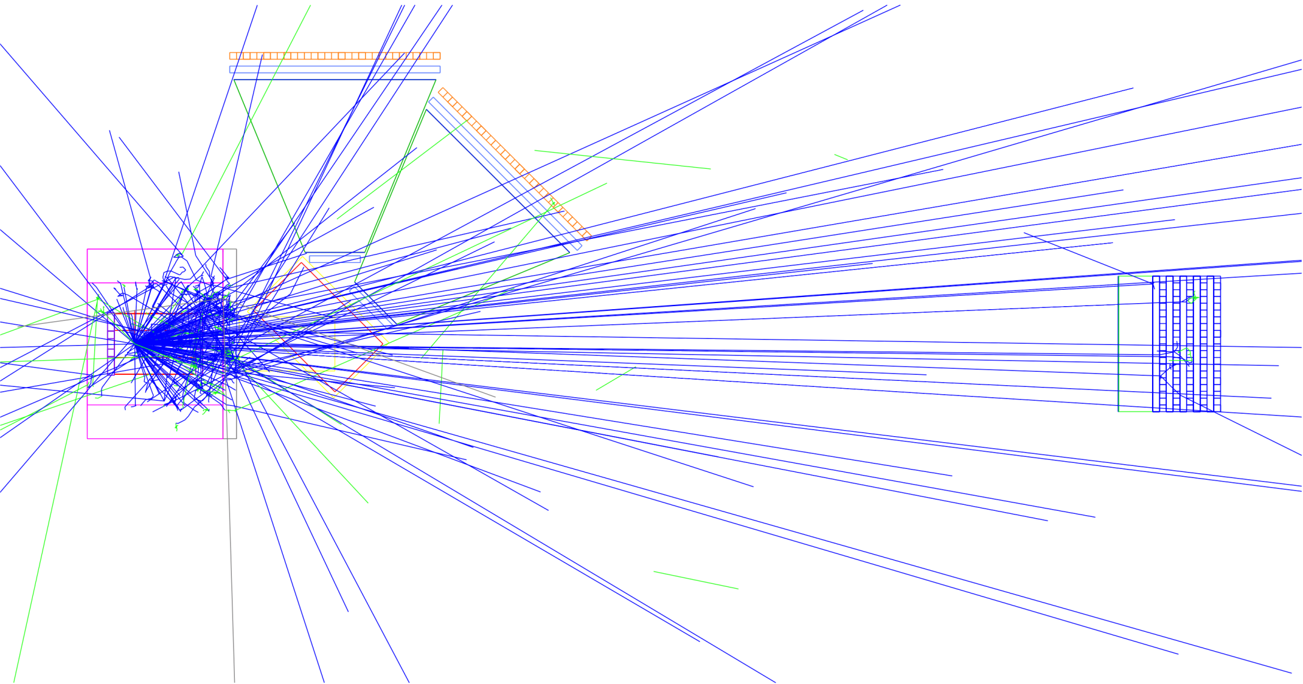
Simulated Event Display
IQMD(SM) for Au+Au at 250A MeV
Neutral particles (γ’s+neutrons) only

Slide 27
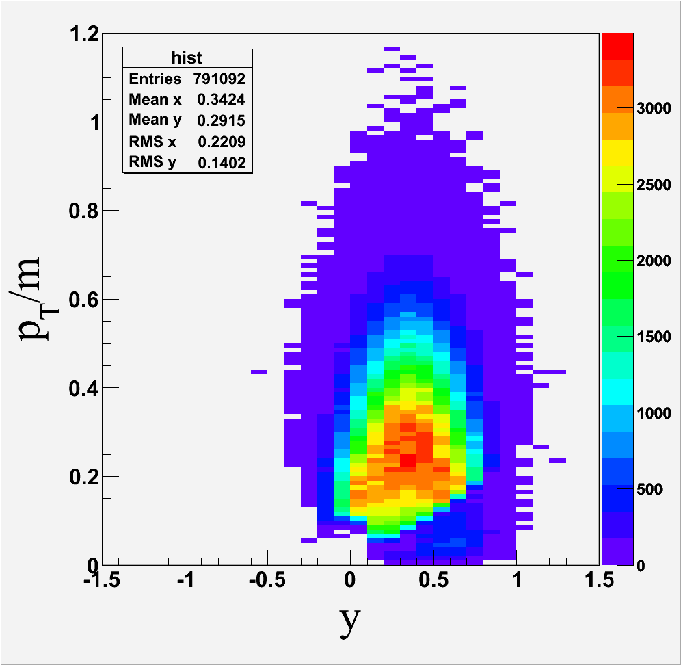
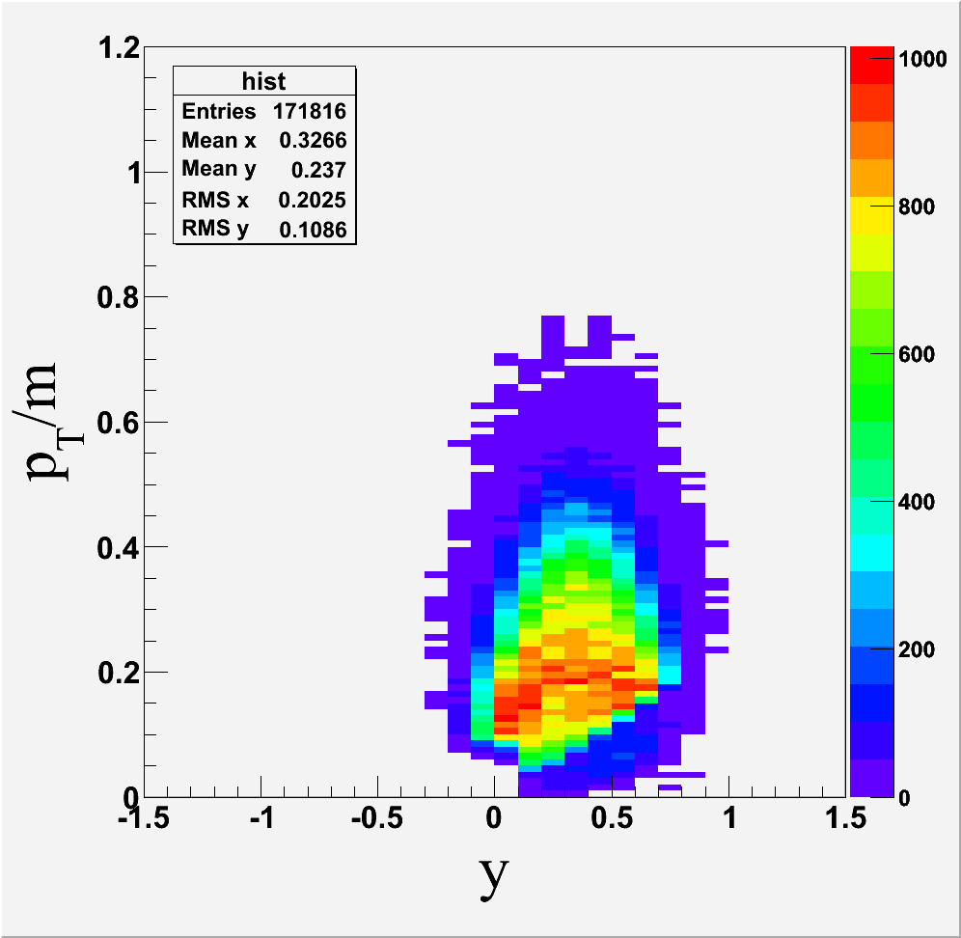
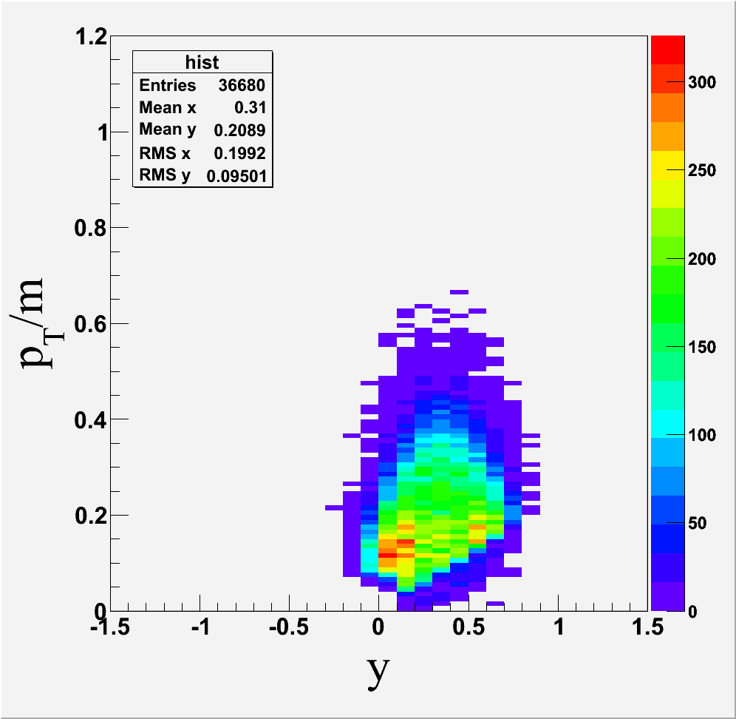
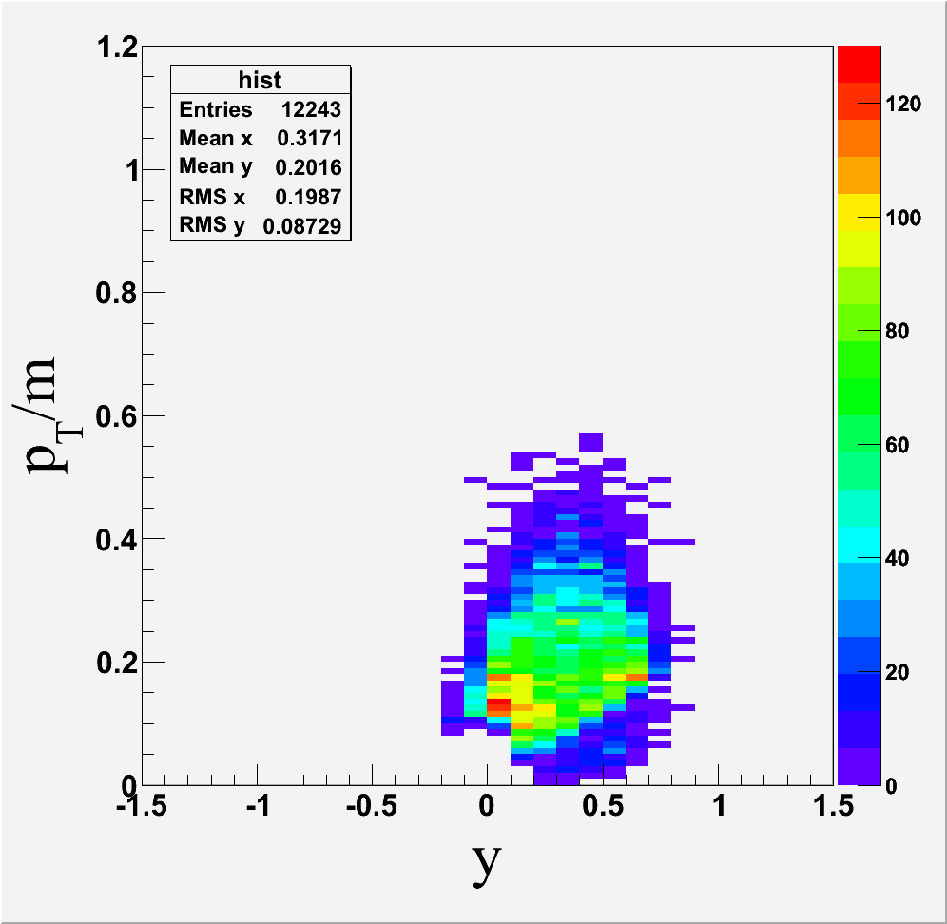
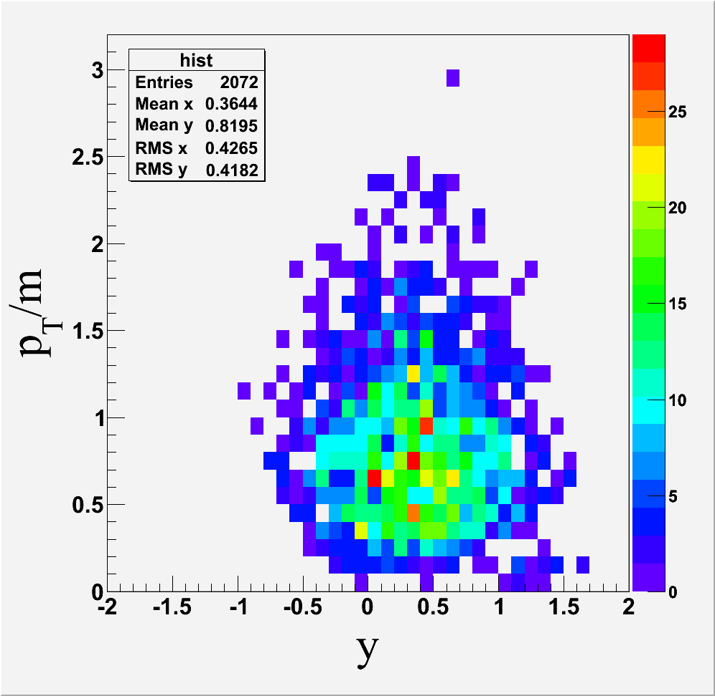
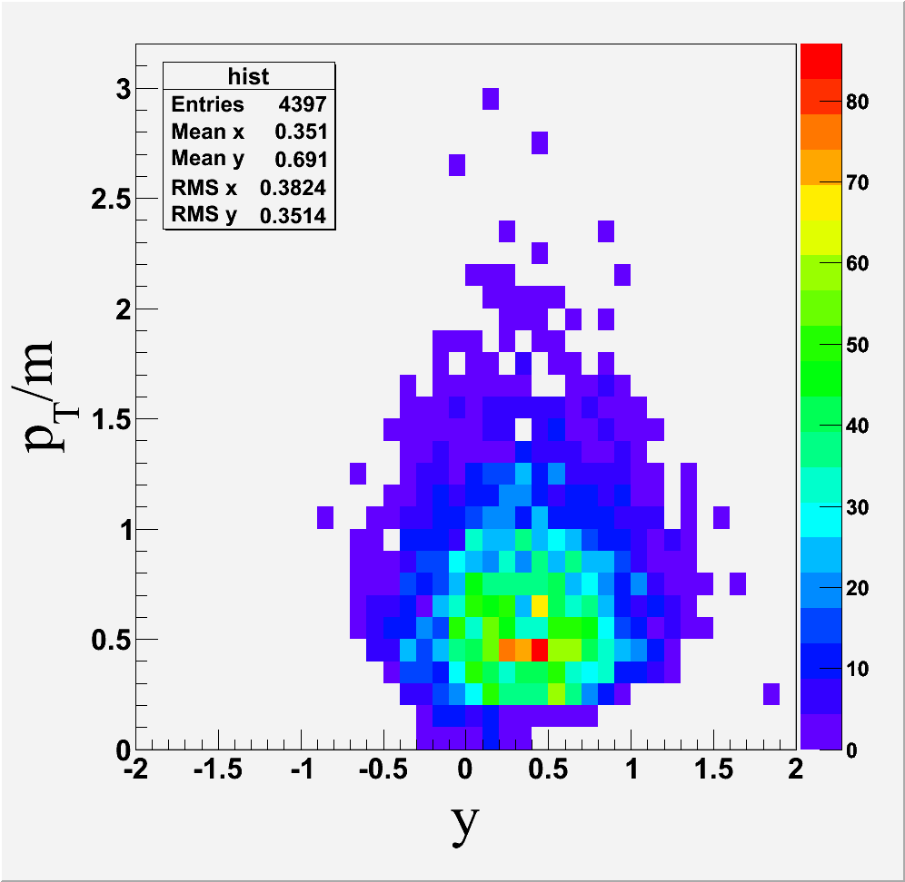
Acceptance of LAMPS
Au+Au @ 250A MeV
p
d
t
⁴He
π⁺
π⁻

Slide 28
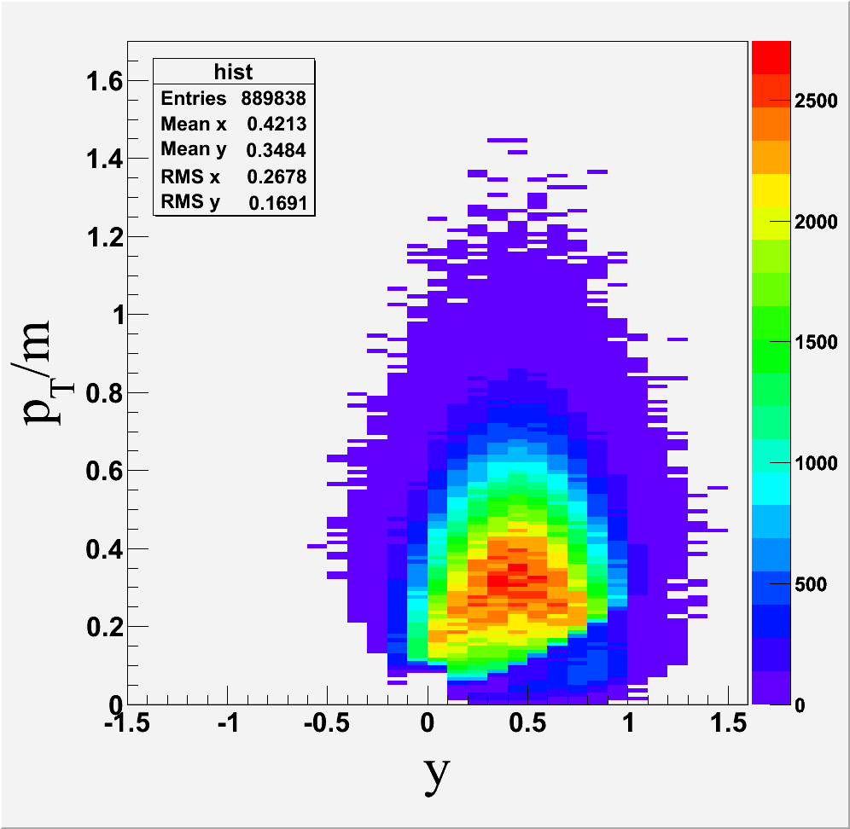
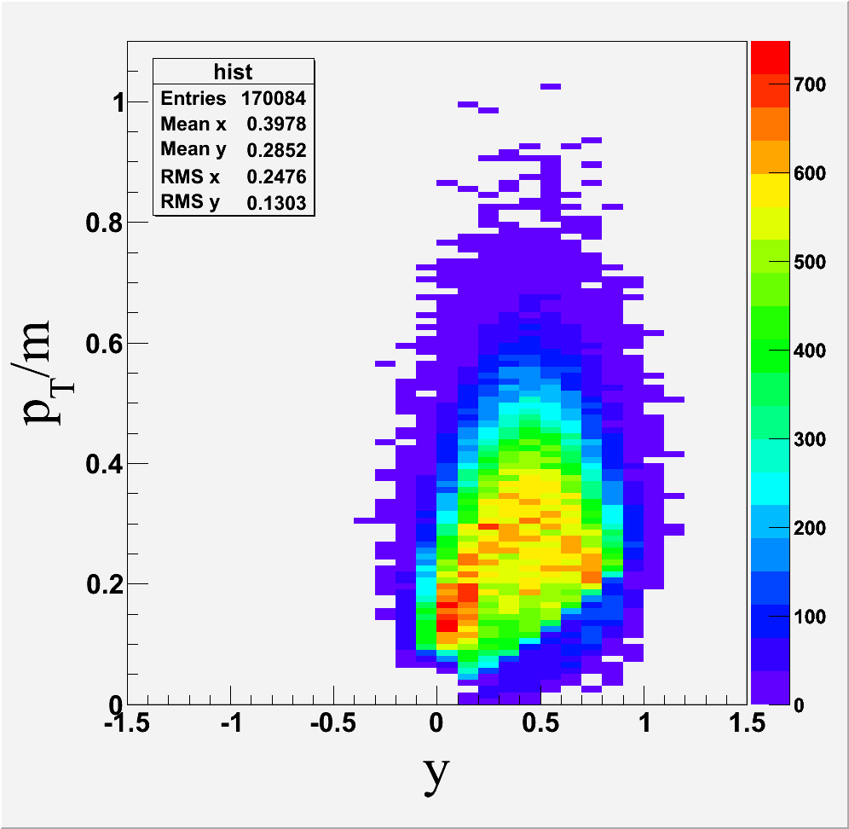
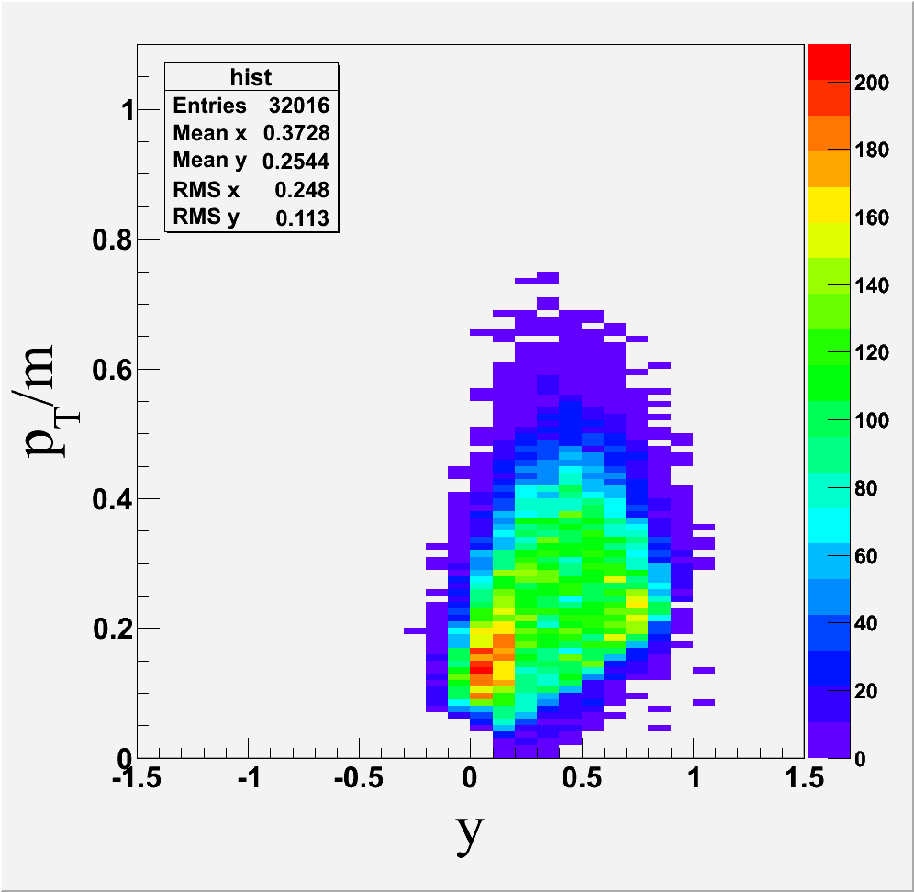
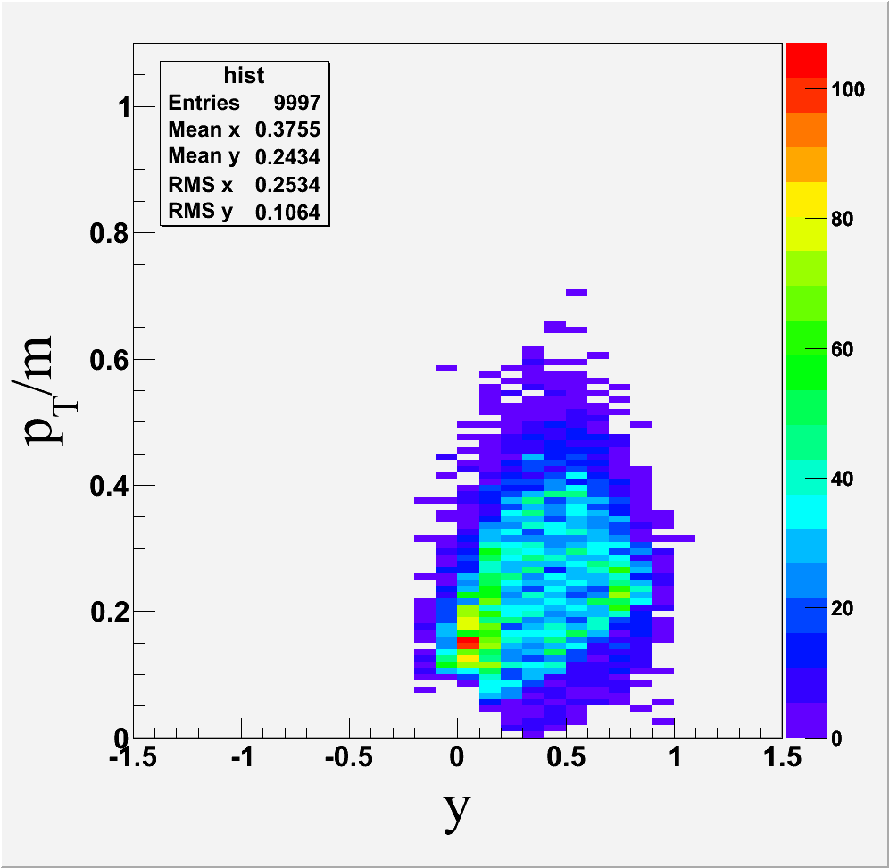
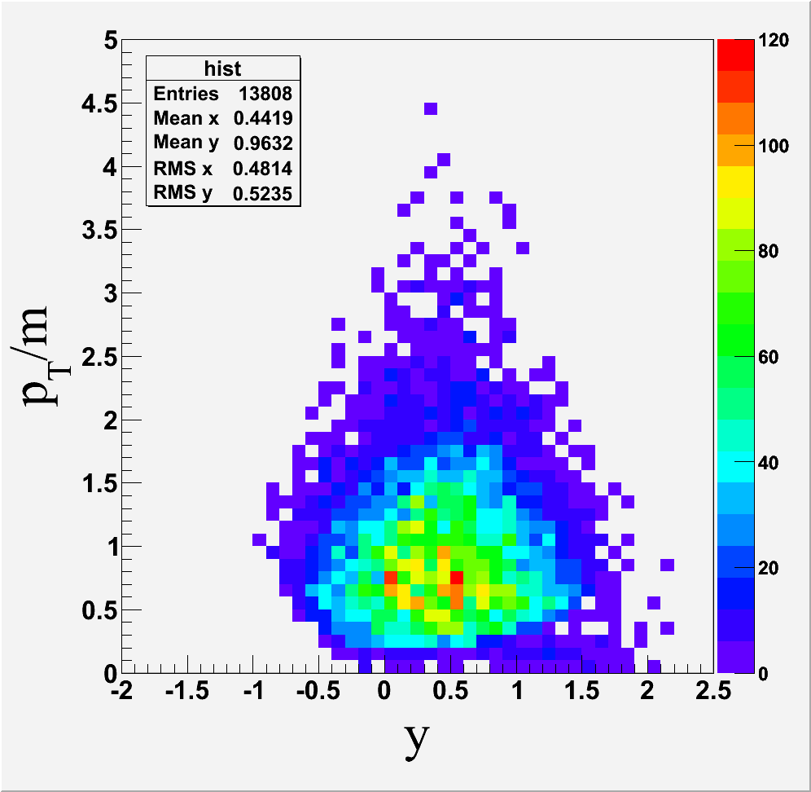
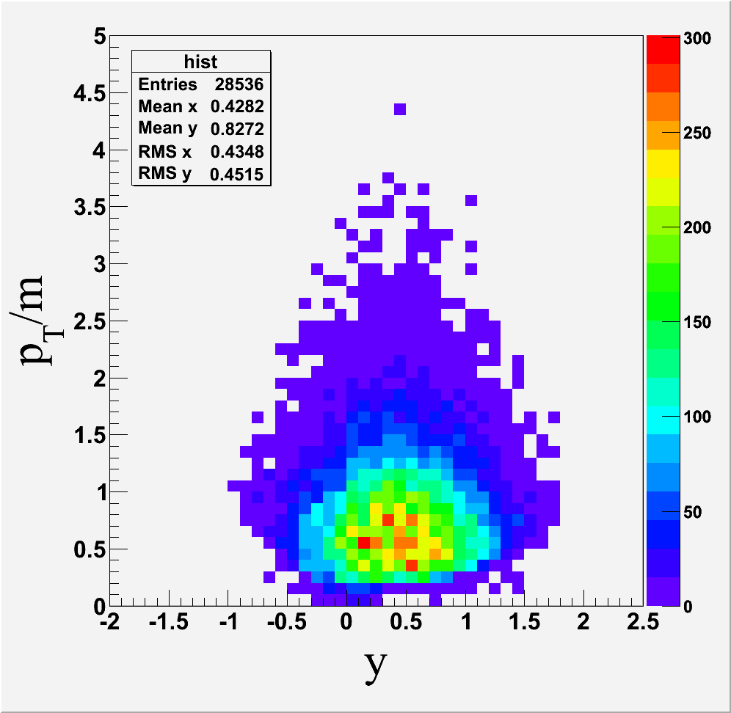
Acceptance of LAMPS
Au+Au @ 400A MeV
p
d
t
⁴He
π⁺
π⁻

Slide 29
Neutron-Detector Array
Important to measure neutrons simultaneously with protons and fragments for the nuclear symmetry energy
Important to measure wide range of the neutron energy
Large detector composed of scintillation slats for the veto and the neutron detectors
y
10 cm
x
z
200 cm
100 cm
50 cm

Slide 30
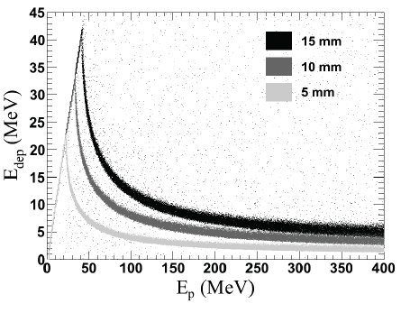
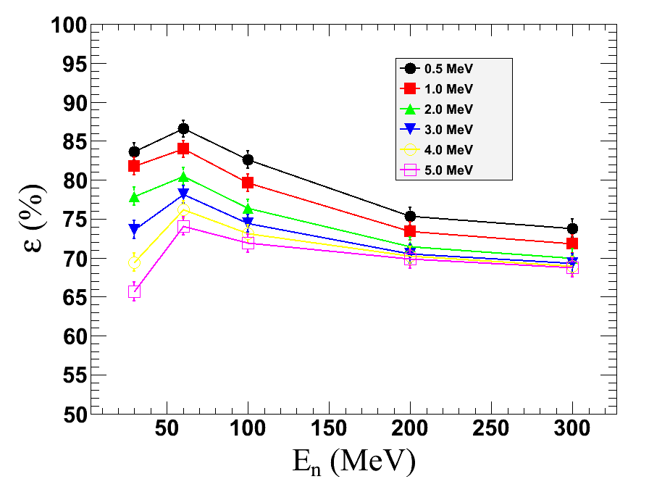
Simulation: Veto Detector
Energy deposition as
a function of proton energy for
different thickness of veto detector
Neutron efficiency of
neutron detector for
various veto thresholds

Slide 31
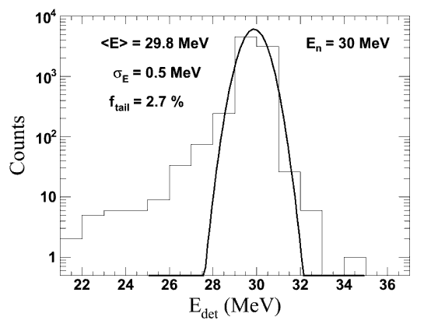
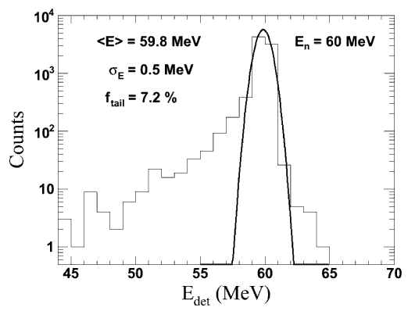

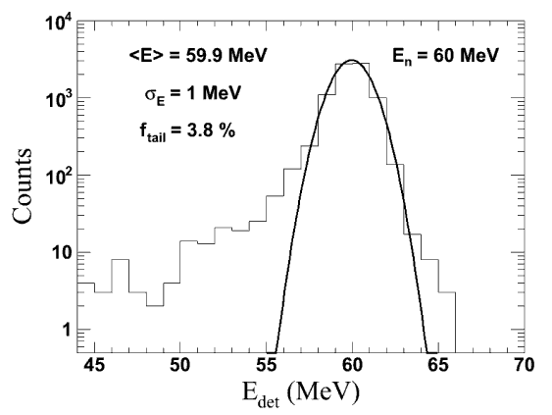
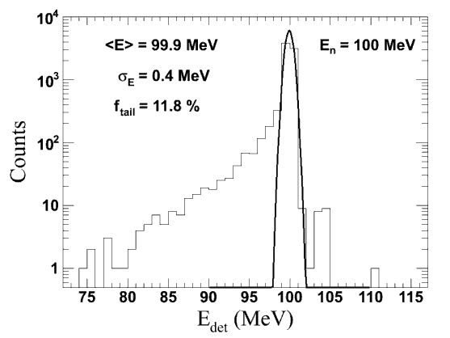
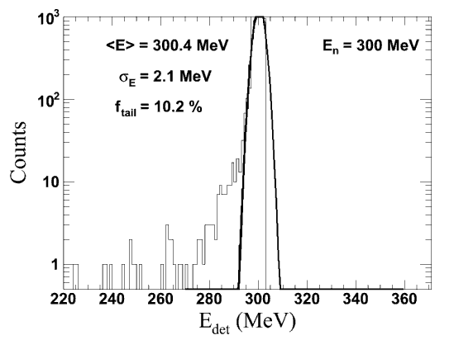
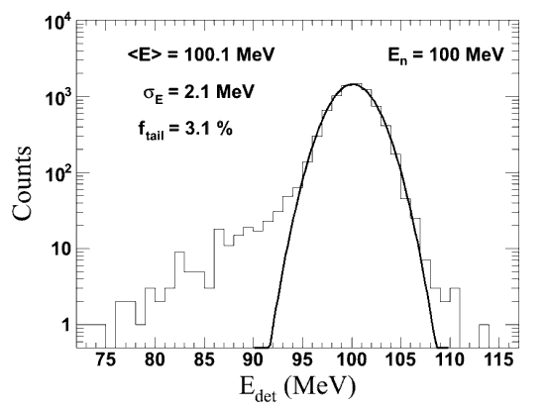

Simulation: Neutron Detector
Assuming Perfect Time Resolution
E_{det} estimated by ToF
Assuming σ_{t} = 1.0 ns

Slide 32


Simulation: Neutron Detector
Energy Resolutions
Tail Fractions
σ_{t} = 0.0 ns
σ_{t} = 0.5 ns
σ_{t} = 1.0 ns

Slide 33






Energy-Deposition Profiles
MeV
gamma 100 MeV
MeV
proton 100 MeV
MeV
neutron 100 MeV
count
count
count
gamma 100 MeV
proton 100 MeV
neutron 100 MeV

Slide 34






Magnets
by S. Hwang & J. K. Ahn
H-type dipole
Pole size: (x, z)=(150 cm, 100 cm)
Maximum B_{y}: ~1.5 T (~4 T for SC option)
Gradient: 1.0 T∙m < ∫B_{y}∙dz < 2.0 T∙m
Solenoid
Size (r, z) : (50 cm, 200 cm)
Maximum B_{z}: about 1.0 T

Slide 35
Summary
Korea Rare Isotope Accelerator (KoRIA)
  Plan to deliver more exotic RI beams using multi-step production and acceleration processes
  Keep the diverse operational modes
Large-Acceptance Multipurpose Spectrometer (LAMPS)
  Large acceptance
  Combination of solenoid and dipole spectrometers
  Movable arms
  Keep the flexibility for other physics topics in the future
Symmetry Energy in EoS
  Crucial to understand the neutron matter & several astrophysical objects
  Long-standing, but yet to be solved problem in nuclear physics
  LAMPS in KoRIA is willing to contribute to this effort.

